Slide 1
Built-Objects in JavaScript:
Built-in objects provide information about
Currently loaded web page
Its contents
Current session of Navigator
Methods for working with properties.

Slide 2
The following are some of the built-in objects in Java script.
1. Document – The document object is the most frequently used java script object, which contains methods and properties to work with form elements, links and applets.
2. Window – The window object provides methods and properties to work with navigator window which includes objects for each frame.
3.History – The history object provides methods and properties about the history list and previous, next visited web page information.
4.Date() - At what time when user access the web page and also keep the current date and time , past and future date and times. JavaScript provides support for working with dates and time through the Date object.

Slide 5
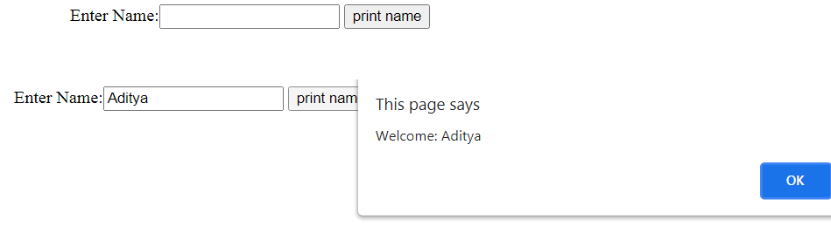
<script type="text/javascript">
function printvalue(){
var name=document.form1.name.value;
alert("Welcome: "+name);
}
</script>
<form name="form1">
Enter Name:<input type="text" name="name"/>
<input type="button" onclick="printvalue()" value="print name"/>
</form>

Slide 6
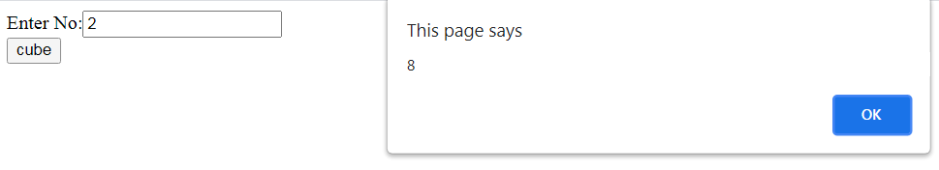
<script type="text/javascript">
function getcube(){
var number=document.getElementById("number").value;
alert(number*number*number);
}
</script>
<form>
Enter No:<input type="text" id="number" name="number"/><br/>
<input type="button" value="cube" onclick="getcube()"/>
</form>

Slide 7
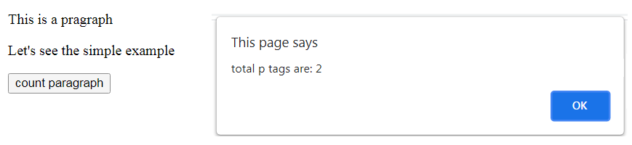
<script type="text/javascript">
function countpara(){
var totalpara=document.getElementsByTagName("p");
alert("total p tags are: "+totalpara.length);
}
</script>
<p>This is a pragraph</p>
<p>Let's see the simple example</p>
<button onclick="countpara()">count paragraph</button>

Slide 8
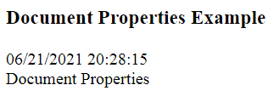
<!doctype html>
<head>
<title>Document Properties</title>
</head>
<body>
<h3>Document Properties Example</h3>
<script>
document.write(document.lastModified +"<br>“)
document.write(document.title +"<br>")
</script>
</body>
</html>

